Slide 1
The European Partnership on Metrology : Opportunities for standardization to collaborate on research projects in 2026
Robert GUNN (NPL) - Chair of STAIR EMPIR
Eveline Domini – LNE
20 October 2025

Slide 2


European Partnership on Metrology
Research metrology programme
Budget ambition
~ 740 M€
Objective: To create, by 2030, a world-class sustainable and coordinated system for metrology in Europe.
Co-funding by Member States and the European Commission
24 participating countries
Funds collaborative research projects related to metrology involving industry and academia
7 annual Calls from 2021-2027
A Normative & Regulation Call each year
21 normative research projects funded so far: 11 projects address a CEN/CENELEC need
CEN/CENELEC needs collected each year by STAIR EMPIR and now the CEN-CENELEC Advisory Committee on Research & Innovation.

Slide 3
European Partnership on Metrology
EPM Calls 2021-2027
2021 Green Deal - Normative 2022 Health, Integrated European Metrology, Digital transformation, Normative, RPot 2023 Fundamental, Industry, Normative, RPot, CSA-CBC
2024 Green Deal, Digitalisation, Normative, CSA (Com&Impact support) 2025 Health, Integrated European Metrology, Regulation 2026 Fundamental, Industry, Normative, RPot 2027 Green Deal, Normative ….
2026 : The Industry and Normative Calls are highly pertinent to standardisation involvement.
Participant Portal: https://www.metpart.eu

Slide 4
How can standardization submit potential research topics?
EURAMET considers important to get some potential needs from industries and society via the standardisation organisations.
To enable that discussion, a common platform STAIR EMPIR (STAndards Innovation &Research) between EURAMET and CEN-CENELEC was created.
Since 2014, via this platform, CEN/CENELEC has consulted its Technical Committees about the emerging research and measurement needs related to standardization and has collected around 15 needs each year.
In addition, metrologists contribute to many standardisation committees on national, European and international level. They are in the best position to identify measurement needs that can generate normative projects.
The research needs coming from the standardization and collected by STAIR EMPIR are considered by the metrology community to develop joint research projects (JRP).
2026 Partnership Calls: CEN and CENELEC TC/SCs are invited to submit their needs for metrology research to the CEN-CENELEC Advisory Committee on Research & Innovation by 16 December 2025.

Slide 5
Role of the standardisation bodies in the Joint Research Projects
Role of the European Standardisation Organisations (ESO) and Regulators:
contributing to the definition of programme calls and being a key exploitation route for the project outputs.
play a key role in identifying needs for better measurements.
For all the projects, EURAMET encourages proposals that include representatives from industry, regulators and standardization bodies for their active participation in the projects.
Target: around 40% of the budget dedicated to external partners.

Slide 6
Joint Research Project specifications
Must include at least 3 National Metrology Institutes or Designated Institutes, each from different countries.
Must be led by a metrologist coordinator or an external organization
Has a maximum duration of 3 years, can be 2 years
Expected to include external partners (funded or unfunded): industry, research organizations, standardization, regulators..
CALL 2026 : Total budget per project :
Normative Projects : 1,3 M€ max. with ≈ 30% dedicated to the external partners.
Industry Projects : 2,3 M€ max. with ≈ 35% dedicated to the external partners

Slide 7
What topics in a Normative Project?
JRPs (Joint Research Projects) are metrology research projects.
Must address topics dealing with traceable measurements methods or validated data sets, as for example :
The development of :
traceable measurement methods for measuring parameters
a new reference materials in close collaboration with instruments manufacturers
a new calibration method
metrological improvements of standardized test methods
calculation uncertainties
The determination of all relevant parameters to design an accurate, robust and stable measuring instrument to elaborate a standardization document.
.

Slide 8
What topics are not relevant in a Normative project?
Topics that:
do not deal with traceable measurements (not selected at the first stage)
do not need research (for example restricted to a simple interlaboratory survey)
address specific needs of a single industrial (JRPs are collaborative research project)
are limited to a national concern (JRPs are expected to have a European dimension)
are urgent and need to be finalized within 3 years : the EPM process required 18 months between the knowledge of the initial problem (PRT) and the start of JRP work (not suitable for some industrial users). The projects selected in the EPM Calls 2026 will start at beginning 2027.

Slide 9
EPM Calls Process
CEN and CENELEC TCs can submit a metrology research need that assist their standardisation work and can be taken up in a PRT
Input from CEN-CENELEC December Year – 1 through the CEN-CENELEC R&I consultation
Stage 1 : Submission of ideas Jan – Feb PRT = Potential Research Topic
Selection of the best ideas (EURAMET) Apr-May
SRT = Selected Research Topic
Stage 2 : Call for proposals for the SRT
Consortia write the project proposals Jun – Sept
Review of proposals (external referee) Nov
Start of work Year+1/1st Semester

Slide 10
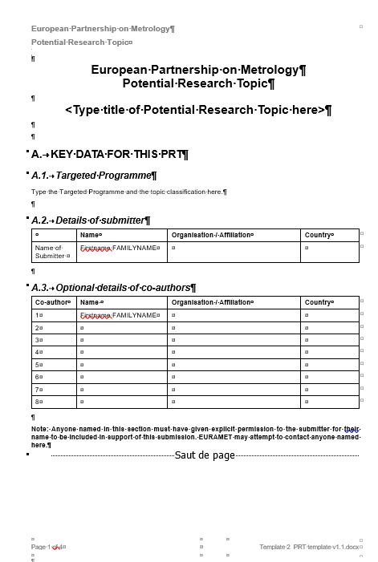
Stage 1 : Submission of ideas
Anyone can submit a Potential Research Topic (PRT)
PRT Template : 5 pages maximum : the submitters, the scientific objectives, the stakeholder needs and the potential impact of the proposed research.
What helps the selection of the PRT :
Early discussion between metrologist and standardisation experts
CEN-CENELEC co-authoring the PRT
Need from the CEN STAIR consultation
3 metrology institutes with a potential budget.
It does not imply any commitment of submitters even when the PRT is selected.
Call 2026 : PRT to be submitted from 8 January to 16 February 2026.
PRT Template
Available at http://www.metpart.eu/applicants

Slide 11
Stage 2 : Preparing the project proposal
Selected Research Topics are public
Forming the consortium, writing and costing the proposal
Partners and Stakeholders decide how much they want to be involved and contribute to the works :
Have valid contributions and deliver tasks that can be funded.
Standardization representatives can be leaders of the impact Work Package. Funded and unfunded partners sign an agreement with EURAMET.
Offer guidance/support without any tasks to deliver and don’t sign an agreement (collaborator or member of the stakeholder group).
The standardisation group generally provides a letter of support joined to the project proposal to demonstrate the support of the standardisation.
Call 2026 : JRP proposals to be submitted from 24 June to 28 September 2026.

Slide 12
How can standardisation submit research needs for the 2026 EPM call?
Each year, all CEN and CENELEC TC/SCs are invited to submit their needs for metrology research to CEN-CENELEC Research & Innovation.
October 2025: email sent to all CEN and CENELEC TC/SCs.
The Response Form has to be sent to metrology@cencenelec.eu
by 16 December 2025.
Response form is available at https://www.cencenelec.eu/get-involved/research-and-innovation/collaboration-agreements/standards-metrology/
From now, it is recommended to have early exchanges between TC/WG and metrology experts to ensure to collect relevant metrology research topics and a higher quality of the PRT :
Discuss with metrology institutes involved in your TC/WG
Contact CEN CENELEC to organize an exchange with EURAMET experts.
Standardisation needs are published on EURAMET website in January for a wider dissemination.

Slide 13
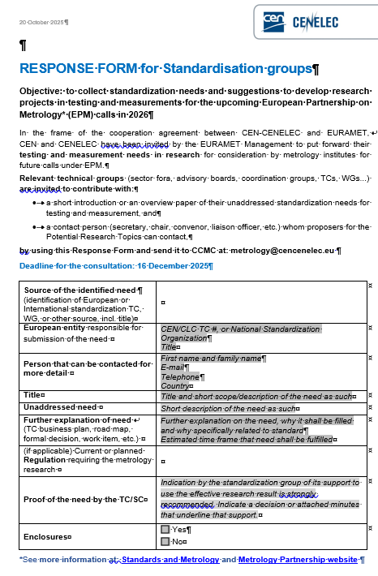

It can happen
All standardization needs will not result in a PRT :
depending on the metrology institutes interested,
their internal strategy, their budget….
at least 3 for the JRP,

Slide 14
This year’s opportunity - recap
Submission of metrology research needs by standardisation by 16 December 2025.
Recommended prior discussion between metrology researchers and standardizers to qualify relevant topics.
Contacts at CEN-CENELEC:
Sebastian Vogel (CCMC) : SVogel@cencenelec.eu
Contacts at EURAMET:
Eveline Domini : Eveline.domini@lne.fr

Slide 15

More information:
EURAMET Website : https://www.euramet.org/
The EUROPEAN Partnership on Metrology
https://www.euramet.org/research-innovation/metrology-partnership
Metrology Partnership website - the portal for participants and applications: https://www.metpart.eu/

Slide 16
2026 NORMATIVE Call Scope (1)
ANNEX
“Metrology support for Regulation and Standards”
Potential Research Topics (PRTs) submitted in response to this call should describe research and development needs for metrology solutions required for standardization, regulation, and conformity assessment.
Research topics should address :
Specific documented demands of European and international Standards Developing Organisations (SDOs) for metrological research in any area.
Proposals may address the development of measurement methods to ensure traceability, the provision of validated data sets, which are required for documentary standards.
The demand for the research shall be demonstrated by clear reference to the measurement needs within strategic documents published by the SDO, by a letter signed by the convenor of the respective SDO TC/WG or by their co-authorship of the PRT.
The metrological background of EU regulation, by either responding to documented requirements or by exploring the background and feasibility of expected possible future regulation. Proposals may address the development of traceable measurement methods or the provision of validated data sets, which are required for these purposes.

Slide 17
2026 NORMATIVE Call Scope (2)
ANNEX
“Metrology support for Regulation and Standards”
EURAMET encourages proposals that
respond to challenges related to setting global and European standards in support of the Annual Union Work Programme for European Standardisation for 2025¹ , and the Industrial Action Plan on the Future of the Automotive Sector2 , or
reflect standardisation needs related to European Partnerships, Missions, or other research initiatives and actions under the Horizon Europe programme.
Proposals should include representatives from industry, regulators, and standardisation bodies, specifically to ensure that the project outputs are taken up by the SDO or regulatory authority.
EURAMET wishes to generate benefit for European and international stakeholders whilst exploiting the unique capabilities of its member National Metrology Institutes (NMI) and Designated Institutes (DI).
This call is intended to enable and promote collaborative research going beyond the state of the art and strengthen the mutual co-operation of European NMIs and DIs, leading to coordinated European metrology infrastructures where appropriate.
1 https://eur-lex.europa.eu/legal-content/EN/TXT/?uri=OJ:C_202501818
2 https://ec.europa.eu/commission/presscorner/detail/en/qanda_25_636

Slide 18
2026 INDUSTRY Call Scope (1)
ANNEX
“Metrology for Industry”
The overall strategic aim of the Targeted Programme (TP) “Metrology for Industry” is to develop new or improved measurement methods and techniques for industrial applications. It is aimed at driving innovation in industrial production and facilitating new or significantly improved products through exploiting knowledge in the European measurement institutes. The innovations shall improve the competitiveness and sustainability of existing industrial sectors or support development of new industries based on alternative or new technologies.
In line with the European Union Competitiveness Compass, the Industry Call 2026 mainly expects proposals in the context of the following Union policies:
AI Continent Action Plan¹ to foster the industrial use of AI technologies ²
Clean Industrial Deal ³ to accelerate competitiveness of European industry through metrology.
Advanced Materials for Industrial Leadership⁴ to develop metrology for designed materials with new or enhanced properties and enhanced structural features to achieve specific or improved functional performance
Communication on Building the future with nature⁵ to develop metrology for biotechnology and biomanufacturing.
https://commission.europa.eu/topics/eu-competitiveness/ai-continent_en
These sectors include: advanced manufacturing; aerospace; agri-food; energy; environment and climate; mobility and automotive; pharmaceutical; biotechnology; robotics; electronic communications; and advanced material design.
https://commission.europa.eu/topics/eu-competitiveness/clean-industrial-deal_en
https://research-and-innovation.ec.europa.eu/research-area/industrial-research-and-innovation/chemicals-and-advanced-materials/advanced-materials-industrial-leadership_en
https://ec.europa.eu/commission/presscorner/detail/en/ip_24_1570

Slide 19
2026 INDUSTRY Call Scope (2)
ANNEX
“Metrology for Industry”
Documented industrial needs, innovation support and competitiveness improvement, such as provided through the references included in the Proposed Research Topics will be of key importance.
EURAMET especially encourages proposals from small and medium size enterprises (SMEs) and their active participation in projects.
In addition to the development of technologies and methods, contributions to standardisation shall be investigated as a potential part of the projects.
EURAMET wishes to generate benefit for industry whilst exploiting the unique capabilities of its member National Metrology Institutes and Designated Institutes.
This TP will enable and promote collaborative research in the most demanding fields of industrial metrology going beyond the state of the art.
As with all other call scopes under the European Partnership on Metrology, this TP shall strengthen the mutual cooperation of European NMIs, leading to coordinated European metrology infrastructures where appropriate.

